Slide 1
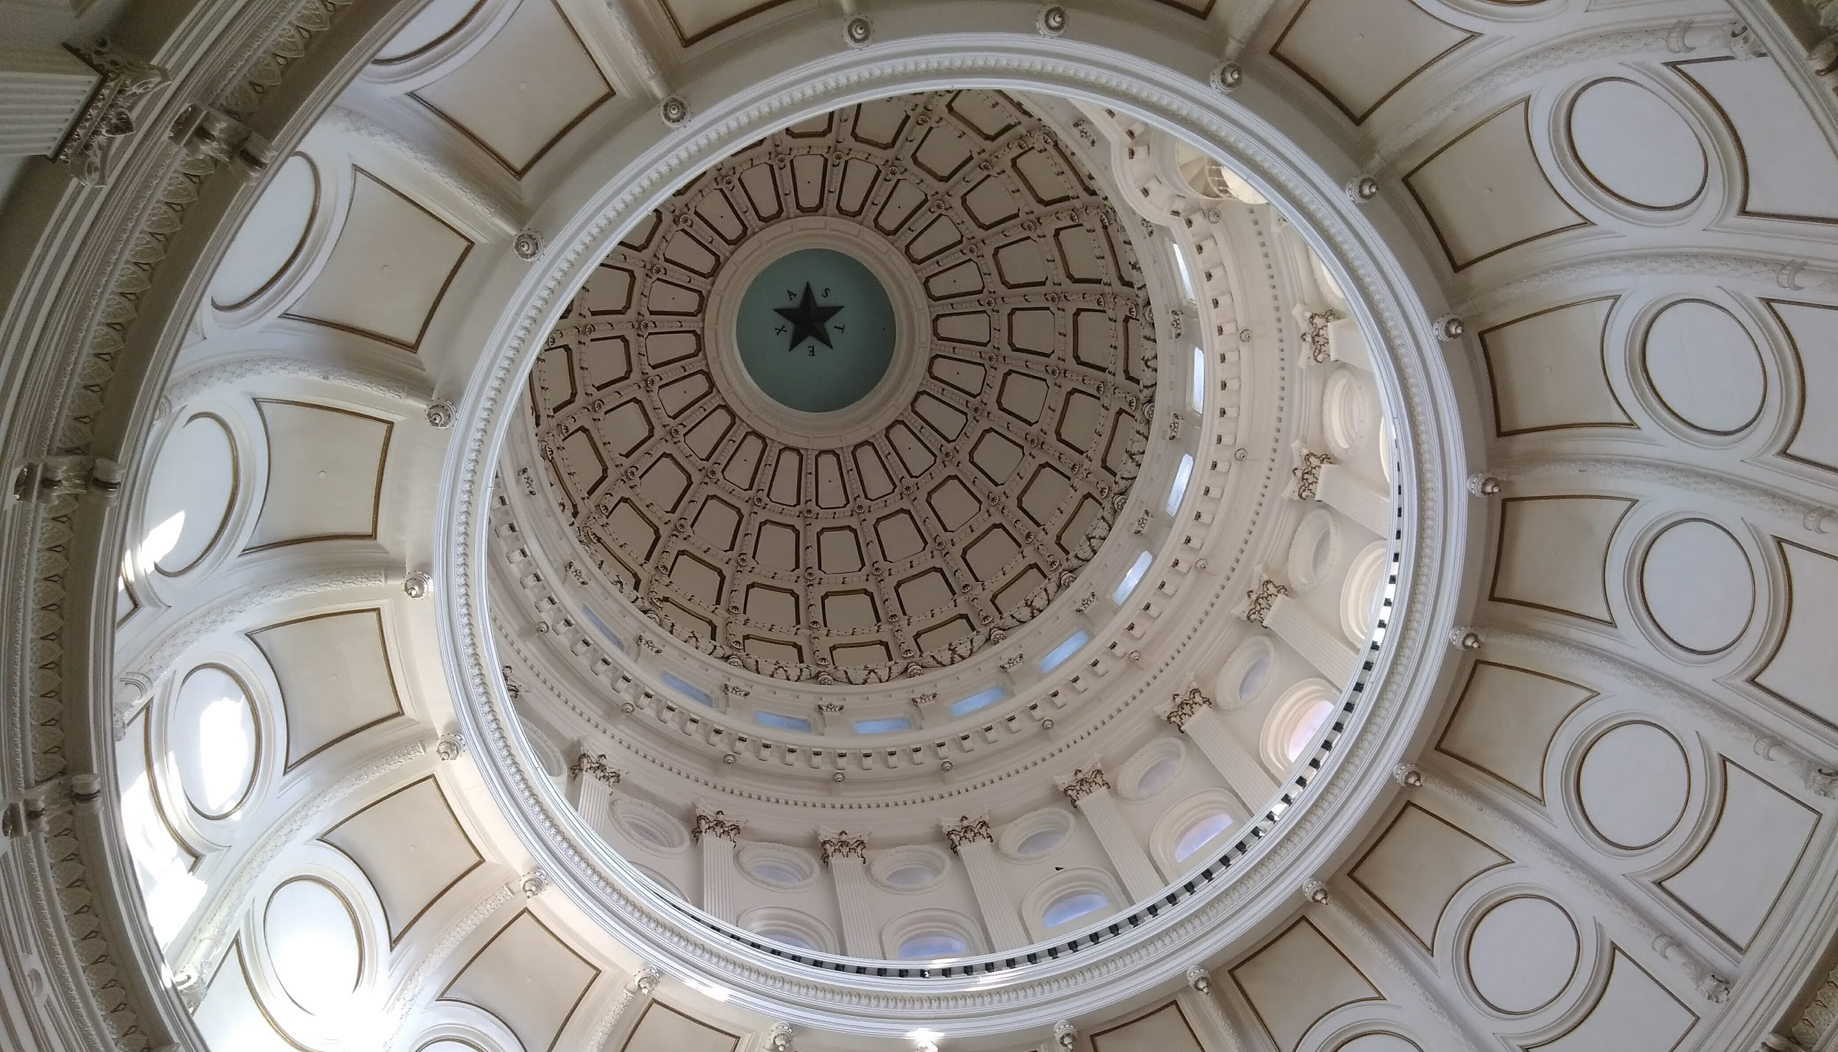
Capitol Advocacy Workshop
Capitol Advocacy Workshop
Saturday, January 12th, 2019
Saturday, January 12th, 2019

Slide 2
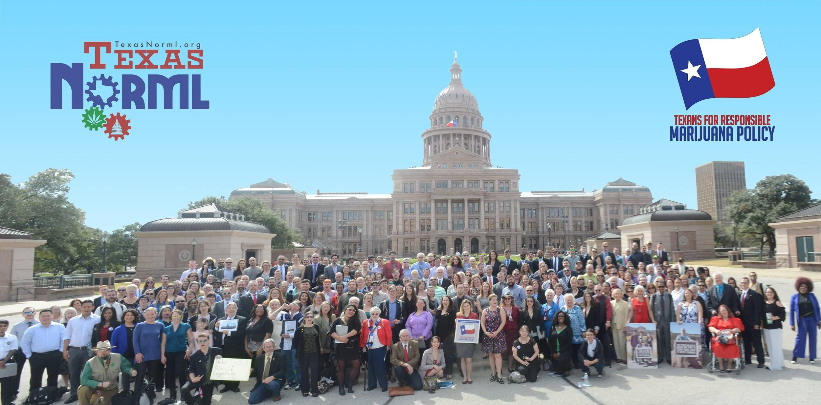
Welcome to the Team!

Slide 3
Constituent advocacy is one of the most critical tools we have as a grassroots movement. Legislators and other community members need to hear from Texans like you who want to see sensible marijuana policies instituted.

Slide 4
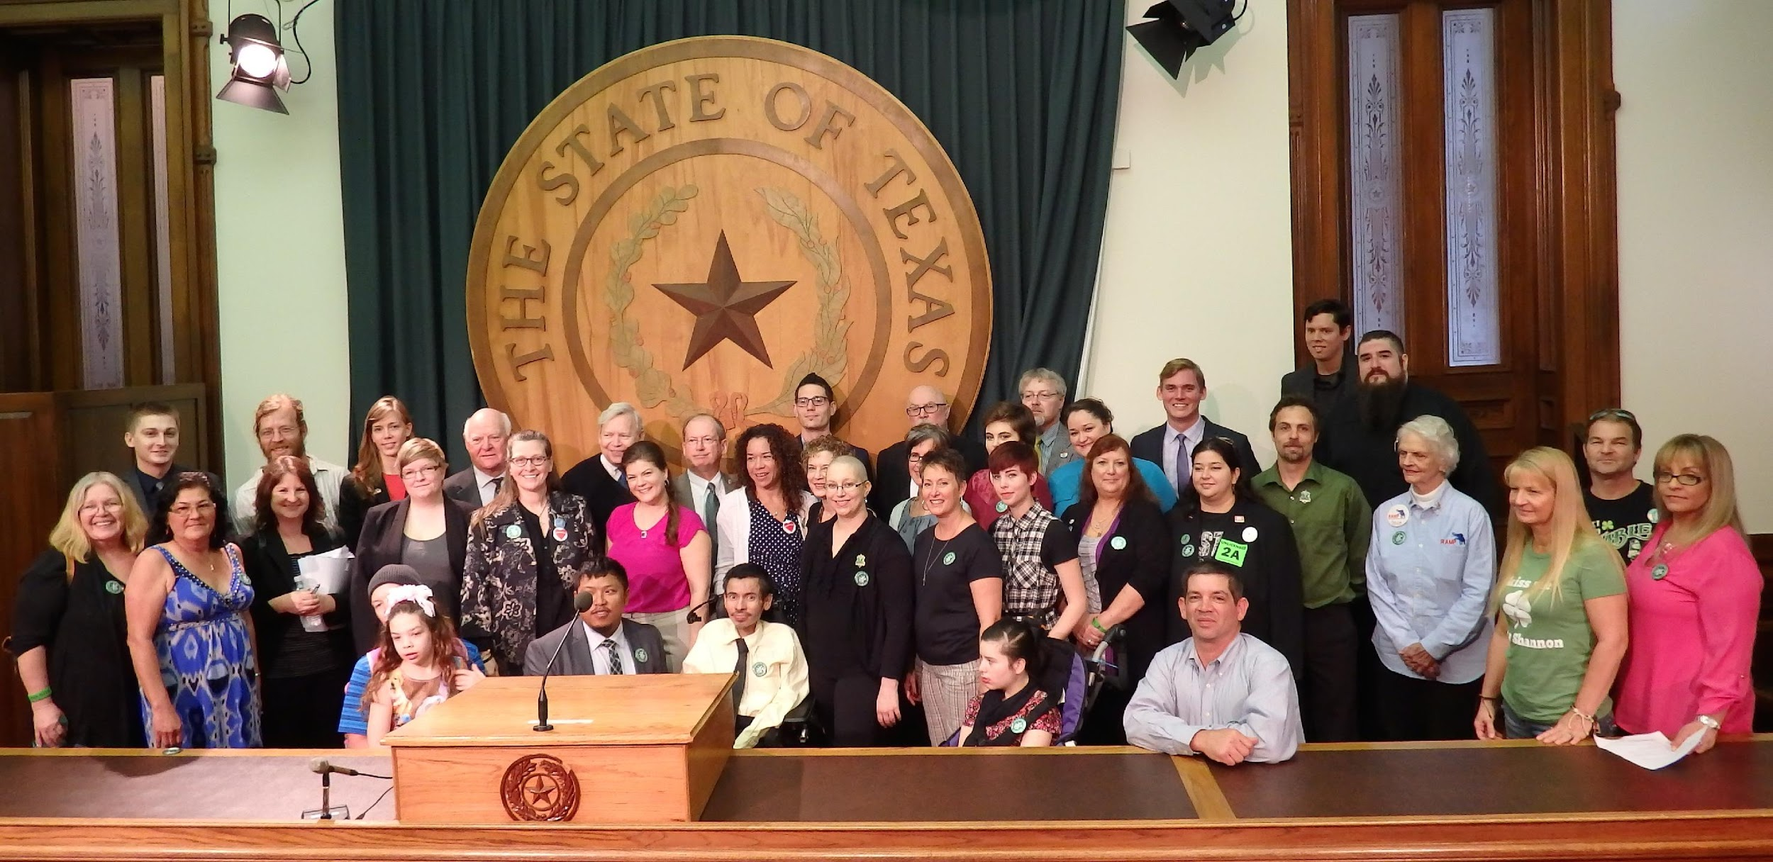
Individual Advocates
Progress is only possible
because of advocates
like you!
Hundreds of Texans
visited their Capitol
to support marijuana
law reform

Slide 5
Individual Advocates
Advocacy is all about building relationships
and effective
communication
(this includes listening
and responding
to concerns)

Slide 6
Where are we now?

Slide 7
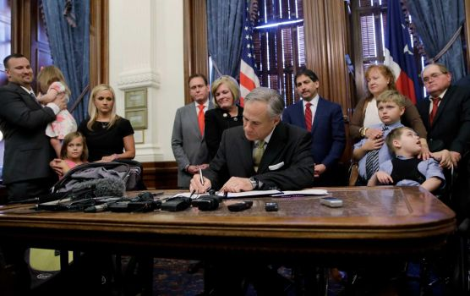
Texas Compassionate Use Program
Signed by Governor Abbott
June 1st, 2015
Authored by Republicans in both the state House and Senate
Passed out of the Senate 30-1
Passed out of the House with more than a super majority
Regulation and licensing overseen by the Department of Public Safety

Slide 8
Who does the program Serve?
Patients diagnosed with Intractable Epilepsy
"Intractable epilepsy" means a seizure disorder in which the patient's seizures have been treated by two or more appropriately chosen and maximally titrated antiepileptic drugs that have failed to control the seizures.

Slide 9
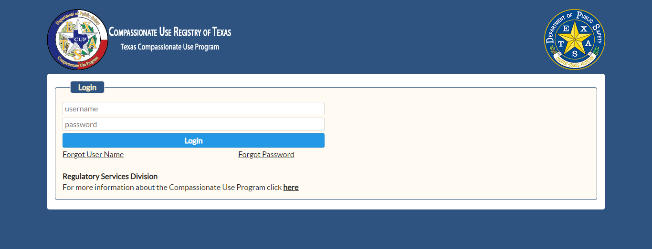
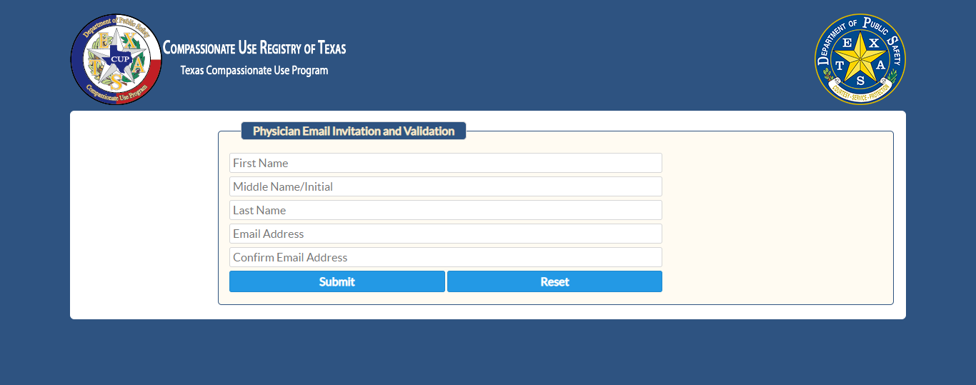
Registry
Department of Public Safety established and maintains an online registry that contains:
the name of each physician who registers as the prescriber for a patient
the dosage prescribed and means of administration ordered
the total amount of low-THC cannabis required to fill the patient's prescription
a record of each amount of low-THC cannabis dispensed by a dispensing organization to a patient

Slide 10
Physicians
A physician is qualified to prescribe low-THC cannabis to a patient with intractable epilepsy if the physician:
is licensed under this subtitle
dedicates a significant portion of clinical practice to the evaluation and treatment of epilepsy
is certified:
- by the American Board of Psychiatry and Neurology in epilepsy or neurology or neurology with special qualification in child neurology
- by the American Board of Psychiatry and Neurology or the American Board of Clinical Neurophysiology in neurophysiology.
input safety and efficacy data derived from the treatment of patients for whom low-THC cannabis is prescribed
A second physician qualified to prescribe low-THC cannabis must concur with the determination and concurrence is recorded in the patient's medical record

Slide 11
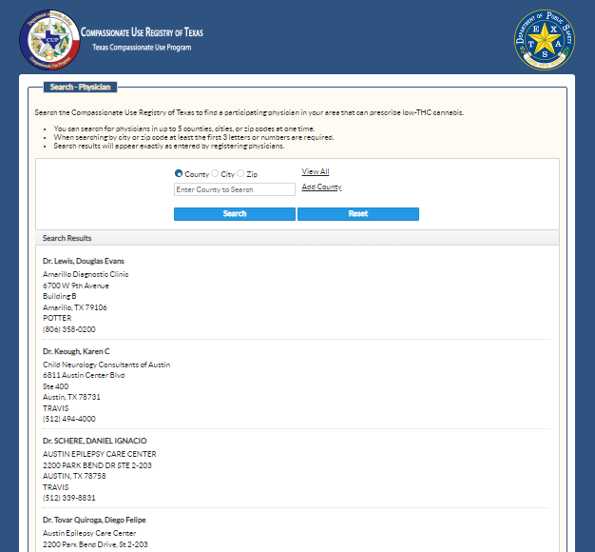
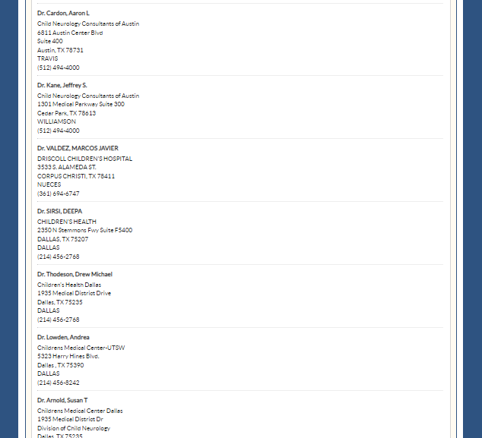
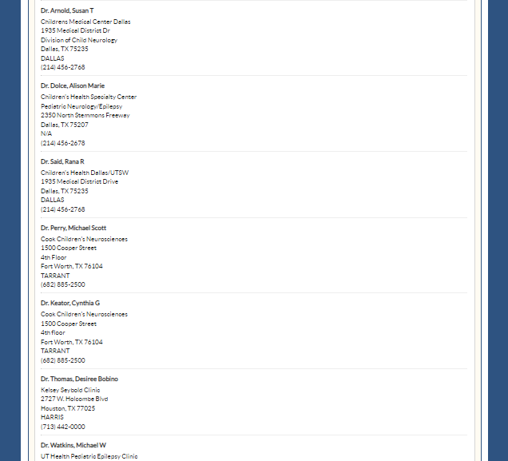
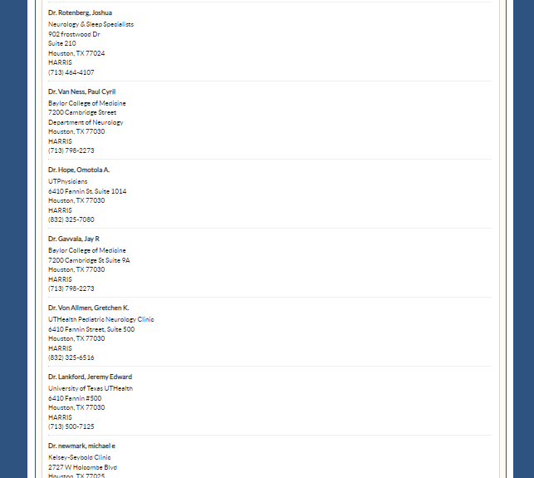
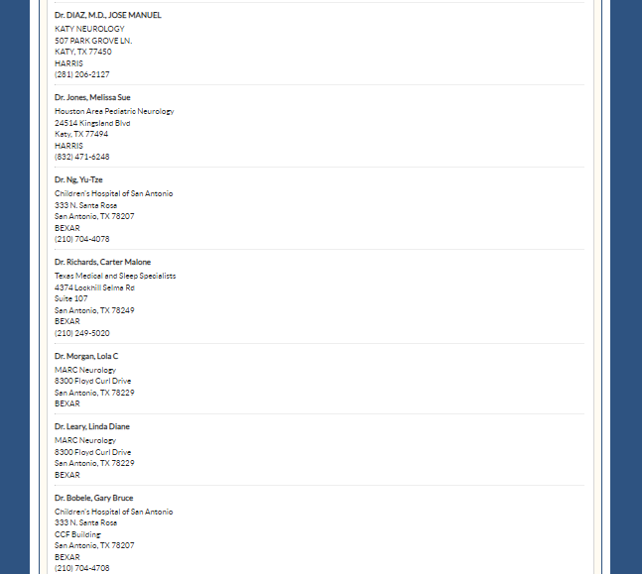
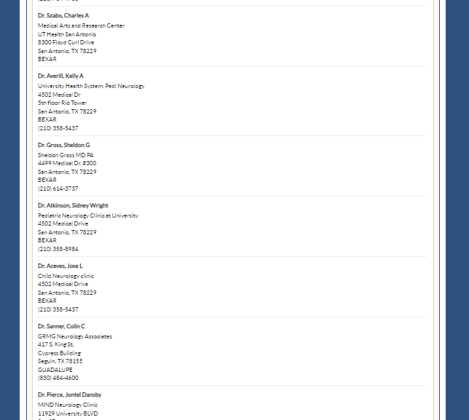
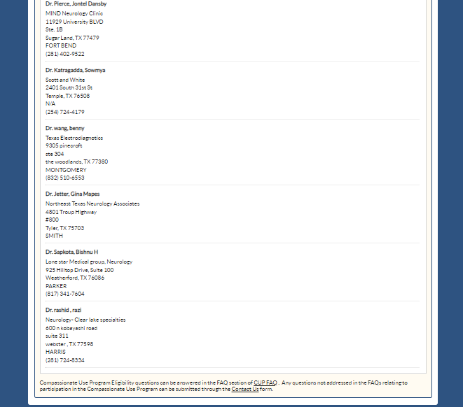
Notes:
43 enrolled physicians

Slide 12
What Kind of Medicine is Available?
"Low-THC cannabis" means the plant Cannabis sativa L., and any part of that plant or any compound, manufacture, salt, derivative, mixture, preparation, resin, or oil of that plant that contains:
not more than 0.5 percent by weight of tetrahydrocannabinols
not less than 10 percent by weight of cannabidiol
"Medical use" means the ingestion by a means of administration other than by smoking of a prescribed amount of low-THC cannabis by a person for whom low-THC cannabis is prescribed. Oils are currently the preferred method.

Slide 13
Dispensing
Compassionate Cultivation by Texas based company with facilities in Manchaca, TX
Cansortium Texas by Knox Medical based out of Florida with facilities in Schulenburg, TX
Surterra Texas by Florida based Surterra with no open facilities

Slide 14
Current Penalties for Marijuana
Offense | Penalty | Incarceration | Max. Fine
Possession or Cultivation
2 oz or less | Misdemeanor | 180 days | $ 2,000
2 - 4 oz | Misdemeanor | 1 year | $ 4,000
4 oz to 5 lbs | Felony | 180 days* - 2 years | $ 10,000
5 - 50 lbs | Felony | 2* - 10 years | $ 10,000
50 - 2000 lbs | Felony | 2* - 20 years | $ 10,000
More than 2000 lbs | Felony | 5* - 99 years | $ 50,000
* Mandatory minimum sentence
Texas NORML
http://norml.org/laws/item/texas-penalties-2

Slide 15
Current Penalties for Marijuana
Sale
7 g or less for no remuneration | Misdemeanor | 180 days | $ 2,000
7 g or less | Misdemeanor | 1 year | $ 4,000
7 g to 5 lbs | Felony | 180 days* - 2 years | $ 10,000
5 - 50 lbs | Felony | 2* - 20 years | $ 10,000
50 - 2000 lbs | Felony | 5* - 99 years | $ 10,000
More than 2000 lbs | Felony | 10* - 99 years | $ 100,000
To a minor | Felony | 2* - 20 years | $ 10,000
* Mandatory minimum sentence

Slide 16
Current Penalties for Marijuana
Hash & Concentrates
Possession of less than 1 g | Felony | 180 days - 2 years | $ 10,000
Possession of 1 - 4 g | Felony | 2 - 10 years | $ 10,000
Possession of 4 - 400 g | Felony | 2 - 20 years | $ 10,000
Possession of more than 400 g | Felony | 10 years - life | $ 50,000
Manufacture or delivery of less than 1 g | Felony | 180 days - 2 years | $ 10,000
Manufacture or delivery of 1 - 4 g | Felony | 2 - 20 years | $ 10,000
Manufacture or delivery of 4 - 400 g | Felony | 5 - 99 years | $ 10,000
Manufacture or delivery of more than 400 g | Felony | 10 years - life | $ 10,000
Texas NORML
http://norml.org/laws/item/texas-penalties-2

Slide 17
Current Penalties for Marijuana
Paraphernalia
Possession of paraphernalia | Misdemeanor | N/A | $ 500
Sale of paraphernalia (first offense) | Misdemeanor | 1 year | $ 4,000
Sale of paraphernalia (subsequent offense) | Felony | 90 days* - 1 year | $ 4,000
To a minor | Felony | 180 days* - 2 years | $ 10,000
* Mandatory minimum sentence
Miscellaneous
Falsifying a drug test | Misdemeanor | 180 days | $ 2,000
A person's driver's license is automatically suspended on final conviction of a drug offense.
Texas NORML
http://norml.org/laws/item/texas-penalties-2

Slide 18
Agenda
Texas Legislative Session 101
Heather Fazio, Texans for Responsible Marijuana Policy
-- Learn about our legislative timeline and currently filed bill
Customize Your Messaging
John Baucum, Republicans Against Marijuana Prohibition
-- Develop your message based on the legislators’ background and interest
Facts and Myths
Carlos Caro, Foundation for an Informed Texas
-- Understand how to dispel common misconceptions with fact based dialog
BREAK (10 minutes)
Written Testimony Workshop

Slide 19
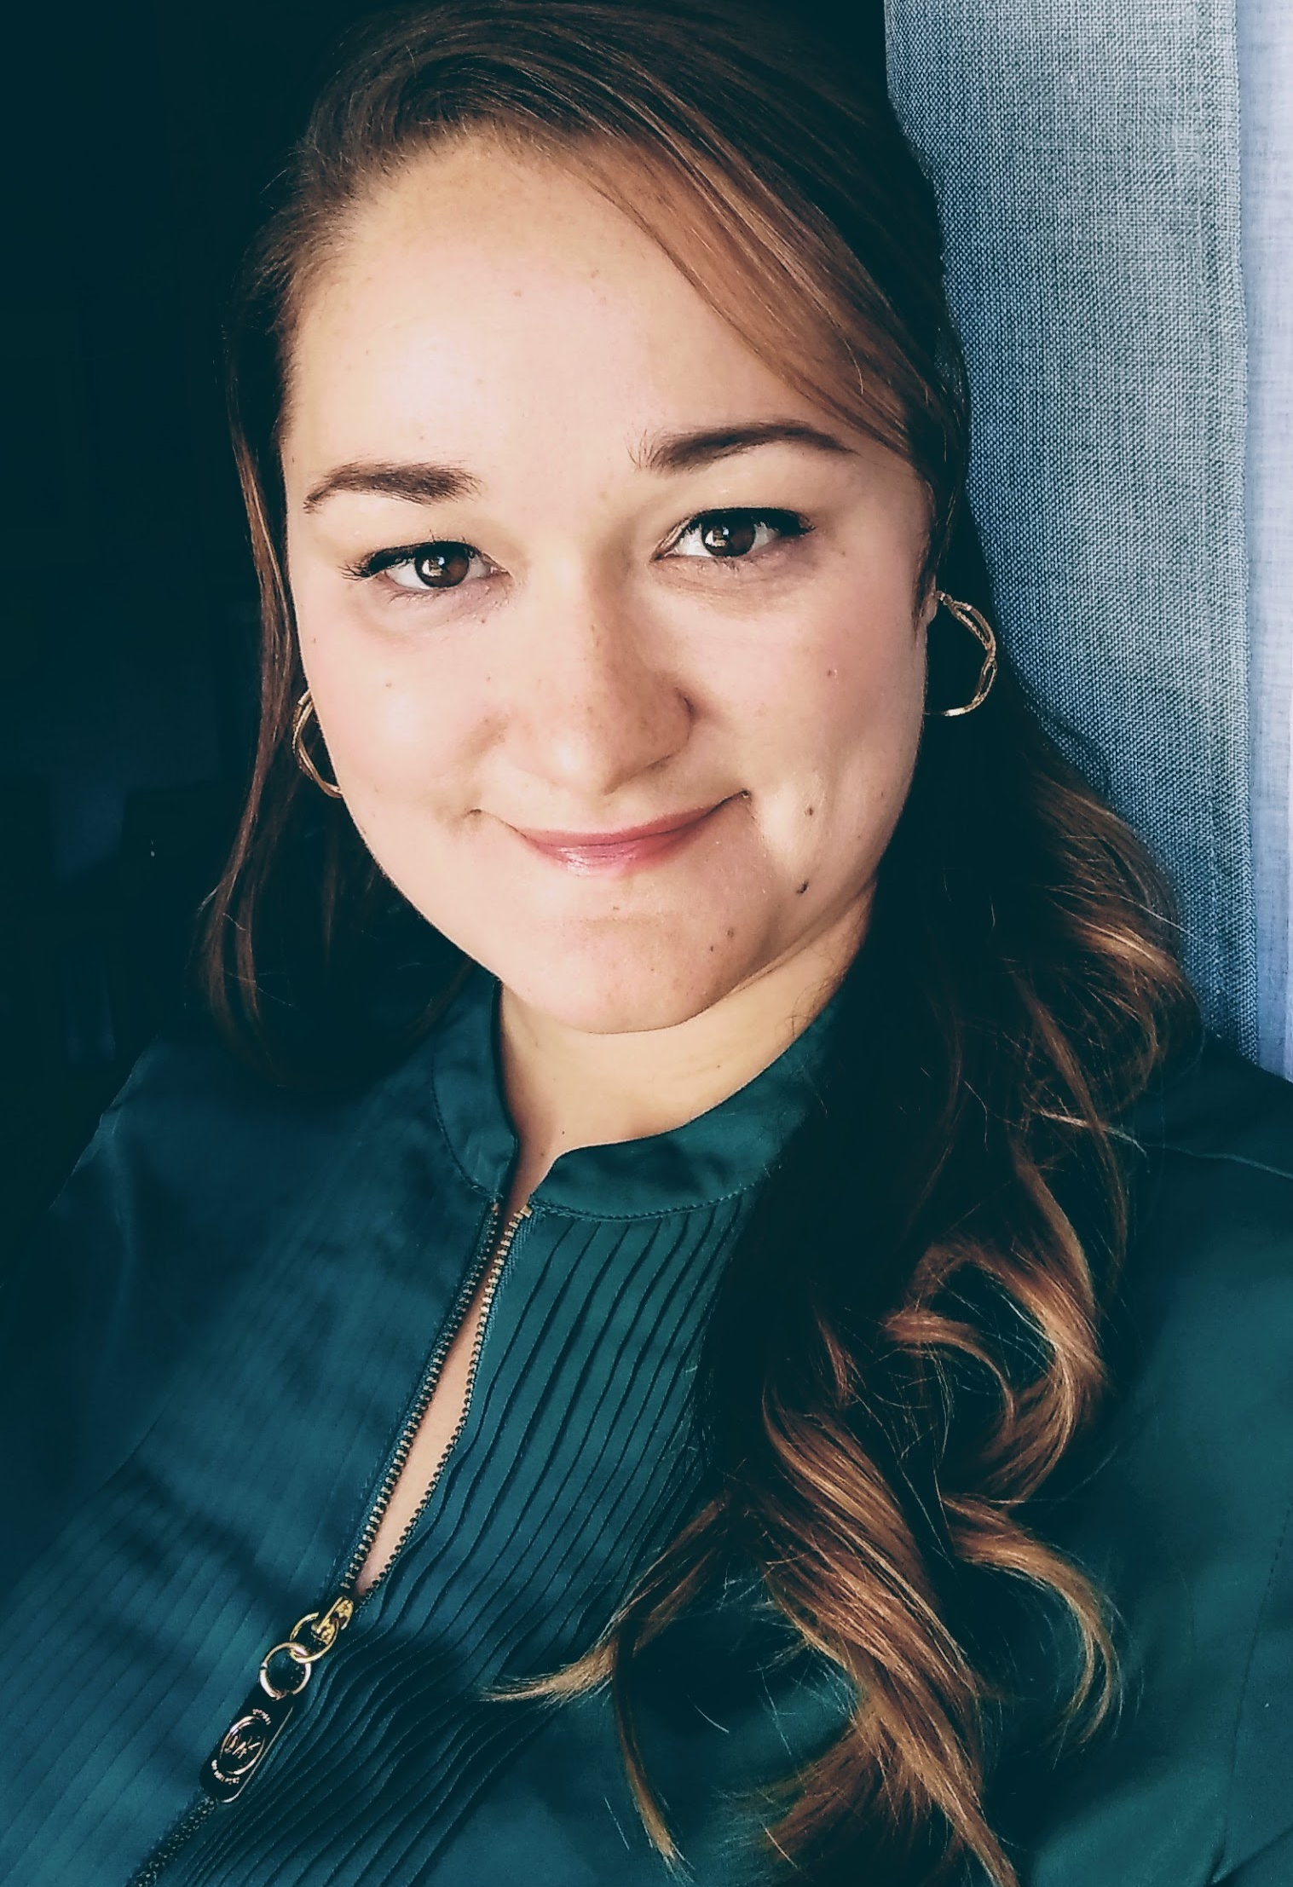
Heather Fazio

Slide 20
Legislative Timeline 2019
January 8 -- Opening Day
February 7 -- LOBBY DAY!
February 18-22 -- Medical Cannabis Exhibit
February 25 -- Veterans Exhibit Lobby Day
March 8 -- Filing Deadline
May 27 -- Adjourn Sine Die

Slide 21
Goals for the 86th Legislative Session
Top Two Priorities:
Reducing penalties for low-level possession
Expand the Compassionate Use Program
- Include patients suffering from debilitating conditions
- Remove arbitrary cap on THC
- Amend language from “prescription” to “certification” for legal purposes
- Add independent labs as legal cannabis businesses for consumer protection

Slide 22
86th Legislative Session
Other Expected Legislation:
Decriminalization (Class B Misd. → Class C Misd.)
Concentrates Limited Medical Cannabis Access
Resolutions for Constitutional Amendments
Hemp Cultivation, Manufacturing, and Product Regulation

Slide 23
Filed Bills -- Reducing/Eliminating Criminal Penalties
HB 63 (Rep. Joe Moody) — Relating to the civil and criminal penalties for possession of certain small amounts of marihuana and an exception to prosecution for possession of associated drug paraphernalia; creating a criminal offense.
SB 156 (Sen. Jose Rodriguez) — Relating to the civil and criminal penalties for possession of certain small amounts of marihuana and an exception to prosecution for possession of associated drug paraphernalia; creating a criminal offense.
HB 335 (Rep. Harold Dutton) — Relating to the penalties for possession of one ounce or less of marihuana and eligibility for placement on community supervision or on deferred adjudication community supervision for that offense.
HB 371 (Rep. Alma Allen) — Relating to the prosecution of and penalties for possession of one ounce or less of marihuana.

Slide 24
Filed Bills -- Concentrates
HB 186 (Rep. Terry Canales) — Relating to the determination of the weight of marihuana and other tetrahydrocannabinols for the purpose of the prosecution and punishment of the offense of possession of those substances.
HB 551 (Rep. Terry Canales) — Relating to the prosecution of and criminal penalties for the possession of marihuana concentrate; creating criminal offenses.

Slide 25
Filed Bills -- Medical Cannabis
SB 90 (Sen. Jose Menendez) — Relating to authorizing the possession, use, cultivation, distribution, transportation, and delivery of medical cannabis for medical use by qualifying patients with certain debilitating medical conditions and the licensing of dispensing organizations and testing facilities; authorizing fees.
HB 209 (Rep. Ron Reynolds) — Relating to authorizing the possession, use, cultivation, distribution, transportation, and delivery of medical cannabis for medical use by qualifying patients with certain debilitating medical conditions and the licensing of dispensing organizations and testing facilities; authorizing fees.
HB 122 (Rep. Gina Hinojosa) — Relating to the medical use of marihuana; providing an affirmative defense to prosecution for possession of marihuana

Slide 26
Filed Bills -- Resolutions
HJR 21 (Rep. Ron Reynolds) — Proposing a constitutional amendment to authorize and regulate the possession, cultivation, and sale of cannabis for medical use.
SJR 7 (Sen. Jose Rodriguez) — Proposing a constitutional amendment to authorize and regulate the possession, cultivation, and sale of cannabis for medical use.
SJR 8 (Sen. Jose Rodriguez) — Proposing a constitutional amendment to authorize and regulate the possession, cultivation, and sale of cannabis.

Slide 27
Filed Bills -- Hemp
SB 116 (Sen. Jose Menendez) — Relating to industrial hemp; requiring an occupational license; authorizing fees.

Slide 28
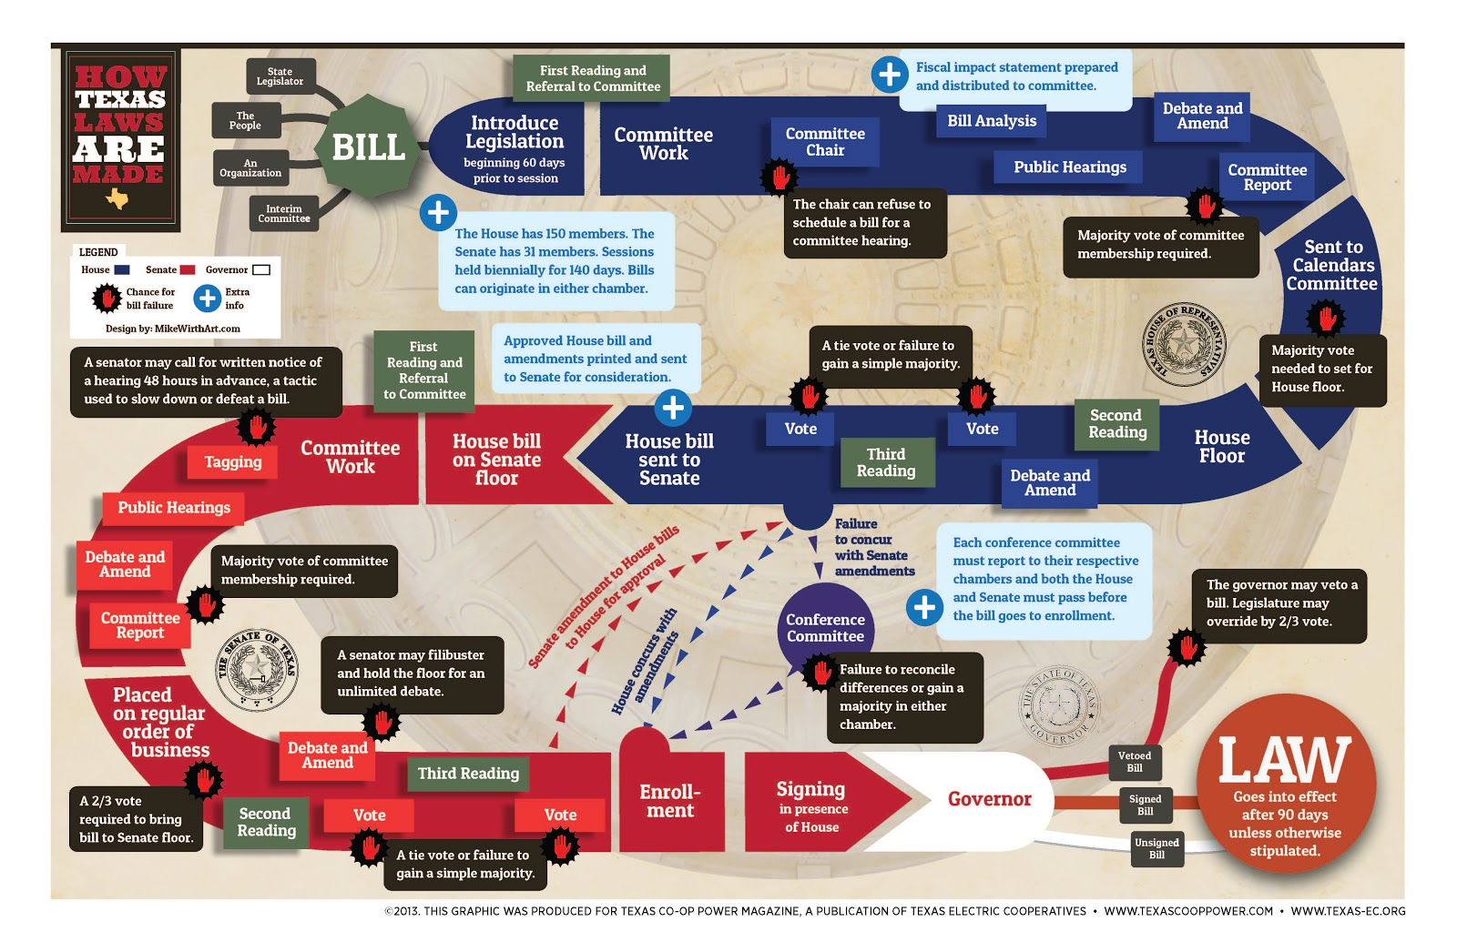

Slide 29
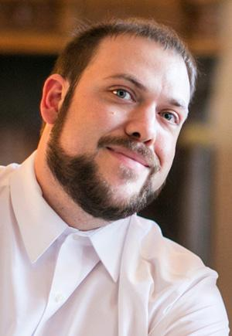
John Baucum

Slide 30
Develop your message
Know your facts and your audience
Stick to your message and don’t get distracted
Be polite, professional, and patient
When speaking to the media, less is more
Notes:
Be sure that you have done your research and understand the information you will be presenting in your meeting. It is very important that the information you share is accurate and from a trustworthy source. Understand who you are speaking to and what motivates them. Try to find some common ground and relate it to your issue. Don’t get distracted by spending too much time discussing things not critical to your objective, or rambling on and on when you’ve already made your point. Be clear and concise with your delivery and make sure that you “ask” is understood before you leave the meeting. Always be courteous and professional. Personal respect for each other will help as you work to develop a relationship as a trusted advisor. It’s important to remember that not everyone has studied this issue as well as you and there might be confusion, misunderstanding, etc. You mush be patient and calmly answer their questions, explaing the nuances of the issue and understanding that they are not likely to become an expert on the policy in one meeting. My personal opinion is that when speaking to the media you should not talk too much. You don’t want to give the editor of the program the ability to craft you message. Instead, it is important to again be clear and concise with your answers so that you are in control of the sound bites that make it on the program. If the program is opposed to your viewpoint, then they will certainly air the dumbest thing you say. Haha.

Slide 31
Talking Points
Proactive communication
Key points and facts that we want to communicate
Look for opportunities to utilize your talking points
Rehearse your taking points and refine your message
Make your case confidently and articulately

Slide 32
Rebuttals
Reactive communication
Responses to typical objections
Be prepared to make rebuttals to counter opposition talking points
Different individuals will have different perspectives
Be honest if you don’t know the answer and ask if you may provide a follow up their question after your meeting

Slide 33
Rebuttal Examples
Didn’t we just legalize medical marijuana?
Only high CBD oil for people with intractable epilepsy
The most effective drug for one person might not work at all for another
Marijuana contains about 80 active cannabinoids (including CBD &THC) and many of them contribute to marijuana’s therapeutic effects
What about the children?
a record can seriously limit a youth’s educational opportunities and scholarship/grants, access to employment, professional advancement, and options for housing
Lowered rates of use in Colorado
Drug dealers do not ID
Many sick children’s parents would like to use cannabis as a first line of defense

Slide 34
Staying on Message is Important
Take your time to organize your thoughts before speaking
Build a bridge from their question to your response
Clearly express the knowledge that we want to convey
Focus on one issue at a time
Remember to listen carefully and don’t get lost in your own mind

Slide 35
Expressing Passion
Humanize the issue by playing on their emotions
Share a personal story about your passion for this issue
Be passionate but don’t become frustrated and angry
Don’t let your emotions get in the way of you making your point

Slide 36
Speaking with the Media
Arrive early
Dress professionally
Be prepared with talking points and notes
If possible, research the person you will be meeting
Stay on message, but be prepared to pivot if needed
Framing the shot and context is important
Keep in mind they are looking for sound bites
Promptly follow up on any questions/requests they may make

Slide 37
Speaking with Elected Officials
Arrive early
Dress professionally
Be prepared with talking points and notes
Research the Official and look for common ground
Prepare for visit with talking points, notes and facts/handouts
Be respectful and courteous
Engage with staff if they are present in the meeting
Thank them for their time
Promptly follow up on any questions/requests they may have

Slide 38
Meeting with Legislators
Texas Senators and Representatives are in charge of state law, decided in Austin, Texas, every legislative session.
Penal Code
State-granted medical marijuana program
U.S. Congressmen and Senators (Cornyn & Cruz) go to Washington, D.C., to impact federal policy.
FDA and DEA approved testing of marijuana
Banking regulations
Legality of crossing state lines

Slide 39
Meeting with Legislators
To find your Federal and State Senators and Representatives go to
https://fyi.capitol.texas.gov/Home.aspx
or Google: “Who represents me.”

Slide 40
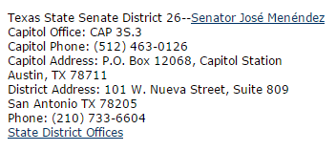
During session
Out of session
During session
Out of session

Slide 41
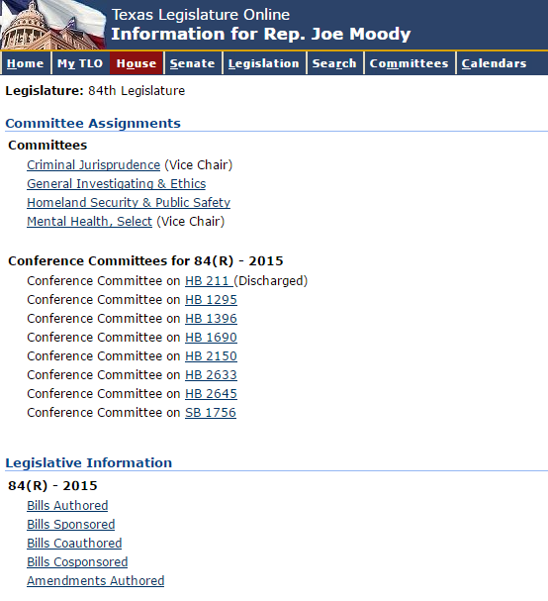
Before You Call
Who is the legislator?
How have they voted?
Review their biography
Review the types of bills they have authored
or co-sponsored
Check out their social media
What committees do they sit on?
Which committees are important to us?
House: Criminal Jurisprudence, Public Health
Senate:
Criminal Justice
Health & Human Services
Use this knowledge to connect with officials and customize your talking points

Slide 42
What to Say When You Call
Ask for the scheduler.
Say you are a constituent who would like to meet the Rep./Sen. when they are in-district or at the Capitol.
Typically they will ask for the topic you are calling about or have you send an email.

Slide 43
What to Say When You Call
If you want to discuss medical marijuana or decriminalization / legalization of marijuana, say:
“I’ve been in the district for ___ years and have never met with Rep./Sen. ___. I’d like some time to speak briefly about health / criminal justice related issues and drop off some materials.”

Slide 44
What to Say When You Call
It is not uncommon for the office staff to drop the ball. It’s okay to be aggressive with a 2nd, 3rd, 4th call.
You may have to schedule a couple weeks out.
Other ways to get in touch with the legislator:
Sign up for their campaign email list
Sign up for the County GOP & Democratic email lists
“Like” them on Facebook / Twitter to catch their events

Slide 45
Building a Relationship
Every state representative is running for office
Campaign staff often double as office staff
Volunteers are not easy to come by - volunteer for campaign or party
Attend local political events to meet lawmakers and community leaders.
Sharing personal stories and experiences sheds light on your perspective.
Follow up with folks you meet who are interested in getting involved. Share this website with them so they can learn more and sign up for email alerts and updates: www.TexasMarijuanaPolicy.org

Slide 46
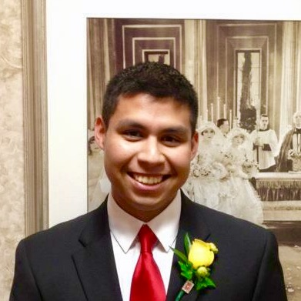
Carlos Caro

Slide 47
Facts and Myths
Annually over 64,000 Texans are arrested for simple possession.
During 2017, 89% of all burglaries, over 60% of all reported rapes, and over 25% of all murders went unsolved.
35% of those arrests are for youth under the age of 21
The State of Texas spends about $10,456 to educate one child for one year, ranked 36th in the Nation. The state spends about $22,000 to incarcerate an individual for one year in a state penitentiary.
84% of Texans think marijuana should be legalized either for medical or recreational purposes.
Notes:
Stats from DPS Annual Crime Report 2017 http://www.dps.texas.gov/administration/crime_records/pages/crimestatistics.htm , UT/Texas Tribune 2018 Poll https://www.texastribune.org/2018/06/27/marijuana-democrats-young-adults-texas-poll/ and from https://www.vera.org/publications/price-of-prisons-2015-state-spending-trends/price-of-prisons-2015-state-spending-trends/price-of-prisons-2015-state-spending-trends-prison-spending

Slide 48
Facts and Myths- Cannabis Reform and the Opioid Crisis
“We already have a massive opioid crisis in this country, why would we want to allow another drug to become more easily available?”
FACT: 72,000 people died from drug overdoses in 2017. Roughly 66% of those deaths were linked to opioids.
FACT: States that have medical cannabis laws have roughly 25% lower opioid overdose rates.
FACT: The easier the access to legal cannabis in general, the lower the rate of opioid prescribing.
Notes:
Cannabis and Opioid Overdoses https://jamanetwork.com/journals/jamainternalmedicine/fullarticle/1898878 https://www.vox.com/science-and-health/2018/8/16/17698204/opioid-epidemic-overdose-deaths-2017, https://www.forbes.com/sites/tomangell/2018/04/02/legal-marijuana-states-have-lower-opioid-use-new-studies-show/#2ea2f2435696

Slide 49
Facts and Myths- Cannabis Reform and Youth Access
Teen marijuana use did not increase or declined in Washington state, California and Colorado after legalization occured.
A meta-analysis of 55 studies has concluded that adolescent marijuana use does not increase after a state legalizes cannabis.
Regulated markets make youth access more difficult than the present model under prohibition.
Notes:
https://www.marijuanamoment.net/teen-marijuana-use-actually-declined-in-washington-state-after-legalization-study-finds/
https://www.marijuanamoment.net/colorado-legalization-didnt-increase-teen-marijuana-use-another-study-finds/
https://www.marijuanamoment.net/teen-marijuana-use-is-down-in-california-following-legalization-state-funded-study-shows/
https://www.marijuanamoment.net/youth-marijuana-use-isnt-increasing-after-states-legalize-meta-analysis-of-55-studies-concludes/

Slide 50
Facts and Myths- Cannabis Reform and the Gateway Theory
FACT: There is no proven gateway effect for cannabis. The use of cannabis does not systematically lead to the use of other, harder drugs.
Correlation does not equal causation.
Origins and Persistence of the Gateway Theory:
1925 Geneva Conference on Opium
1937 Marihuana Tax Act
1951 Boggs Act
1982 Publication of “The Stepping-Stone Hypothesis”
Notes:
https://www.researchgate.net/publication/16214483_The_stepping-stone_hypothesis_-_Marijuana_heroin_and_causality
https://www.newpaltz.edu/media/the-benjamin-center/db_18_the_marijuana_gateway_fallacy.pdf

Slide 51
Written Testimony Workshop
Break out into groups to work on crafting your compelling testimony
Select your topic
Find reliable resources
Select your talking points
Select your personal touch
Write your testimony
Share for feedback
Notes:
JAX

Slide 52
Thank you for coming!
Contacts:
Heather Fazio
HFazio@TXMJPolicy.org
Jax Finkel
Jax@TexasNORML.org
John Baucum
JohnB@RAMPGOP.org
Carlos Caro
Secretary@InformedTexas.org
After Social: Brick Oven Austin (1209 Red River, Austin, TX)

